Slide 1
SMART PARKING
Using ioT to give solution for parking management

Slide 2
TABLE OF CONTENTS
01
02
03
04
INTRODUCTION
PROJECT DEFINATION
Objectives
About project
Component required
DESIGN THINKING
CONCLUSION
Build Idea to solve the problem
Execute the idea

Slide 3
INTRODUCTION
01
Objectives

Slide 4
INTRODUCTION
A smart parking system uses IoT devices and sensors to collect real-time data on parking lot occupancy and transmits this information to the cloud or local network. It also involves building IoT apps for end-users, like parking administrators and drivers.

Slide 5
OBJECTIVES
OverpayingSometimes, drivers still determine how long they will stay in a particular location. As a result, they may pay too much for parking while the duration may be much lesser.
Environmental impactBesides time, a lot of fuel is consumed looking for an appropriate parking space. When it rains, numerous pollutants accumulated in the parking lots get a wash, creating dirty, wet mud and foul smells.
Parking inappropriatelyThe parking lot at the mall or the customer's intended destination is usually insufficient and they end up parking outside the designated spot. It results in greater traffic congestion.

Slide 6
02
PROJECT DEFINATION
About the project and Component required

Slide 7
PROJECT DEFINATION
A vehicle parking system that helps drivers find a vacant spot. Using sensors in each parking space that detect the presence or absence of a vehicle, signs direct incoming drivers to available locations.

Slide 8
PROJECT DEFINATION
ABOUT PROJECT
COMPONENT REQUIRED
ESP32 development board
Ultrasonic distance sensors (HC-SR04) for each parking space3. Breadboard and jumper wires
Wokwi virtual simulator (https://wokwi.com/)

Slide 9
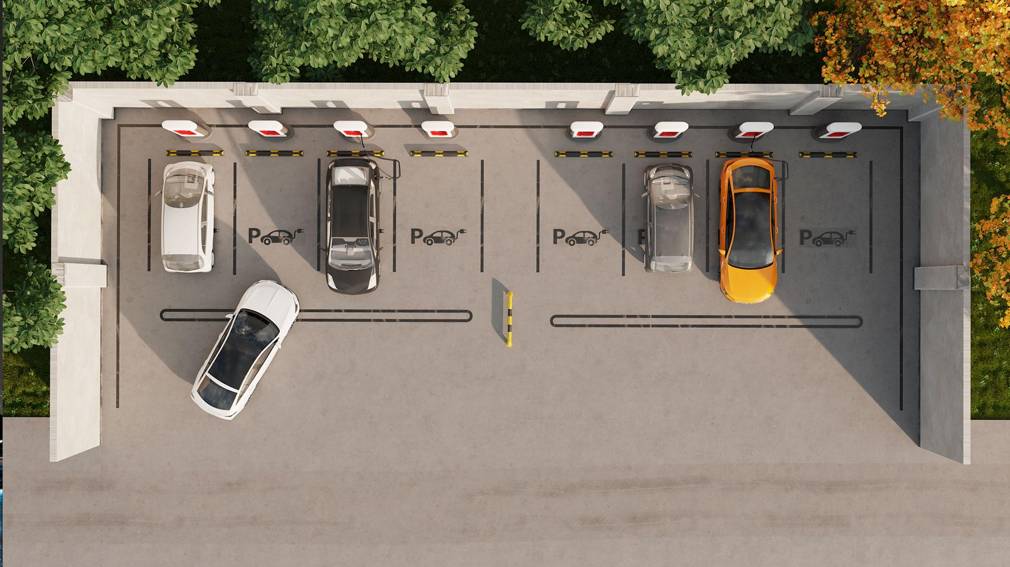
A PICTURE IS WORTH A THOUSAND WORDS

Slide 10
DESIGN THINKING
03
Following 6 steps

Slide 11
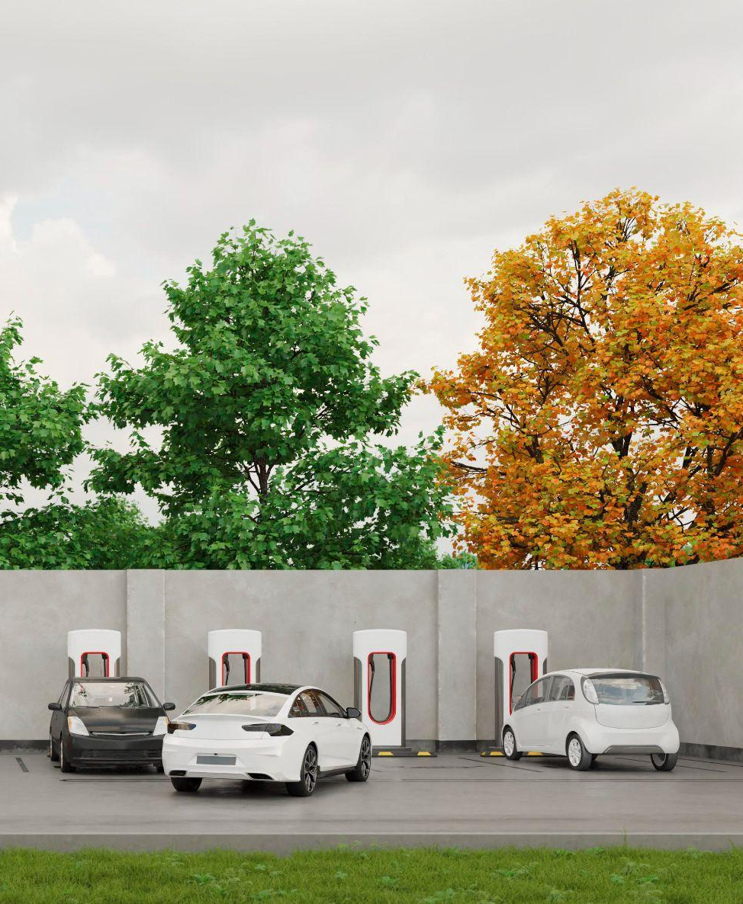
DESIGN THINKING
**Hardware Setup:**
Connect the HC-SR04 ultrasonic sensors to your ESP32 board. You will need one sensor per parking space.
Wire the HC-SR04 sensors as follows:
- VCC to 5V on ESP32
- GND to GND on ESP32
- Trig to a digital GPIO pin on ESP32 (e.g., GPIO2)
- Echo to another digital GPIO pin on ESP32 (e.g., GPIO4)
Connect all the sensors in the same way, one for each parking space you want to monitor.

Slide 12
2. **Programming:**
a. Write an Arduino sketch for the ESP32 that reads the distance data from the ultrasonic sensors.
```cpp
#include <Ultrasonic.h>
Ultrasonic sensor1(GPIO_TRIGGER1, GPIO_ECHO1);
Ultrasonic sensor2(GPIO_TRIGGER2, GPIO_ECHO2);
// Add more sensors if needed
void setup() {
Serial.begin(115200);
}
void loop() {
long distance1 = sensor1.read();
long distance2 = sensor2.read();
// Read distances from more sensors if needed
// Process distance data and manage parking spaces here
delay(1000); // Delay for better readability
}

Slide 13
2.
b. In the loop function, process the distance data from each sensor to determine whether a parking space is occupied or vacant. You can set a threshold distance to decide when a space is occupied.
c. You may want to use a data structure to keep track of the parking space status, e.g., an array of boolean values.

Slide 14
4. **Testing:**
a. Simulate the project on Wokwi and observe how the parking space status changes based on the simulated distance measurements.
b. Fine-tune your code and interface as needed to ensure it works correctly..
5. **Deployment:**
a. Once your Smart Parking project works as expected in the virtual simulator, you can deploy it to a physical ESP32 board and connect it to real sensors in a parking area.

Slide 15
6. **Enhancements:**
Depending on your project's requirements, you can add features such as mobile app integration for real-time parking updates, data logging, and alerts when parking spaces are full or vacant.
Remember to refer to the ESP32 and HC-SR04 datasheets and the Wokwi documentation for detailed information on programming and using these components in your project.

Slide 16
CONCLUSION
04
Execute the idea

Slide 17
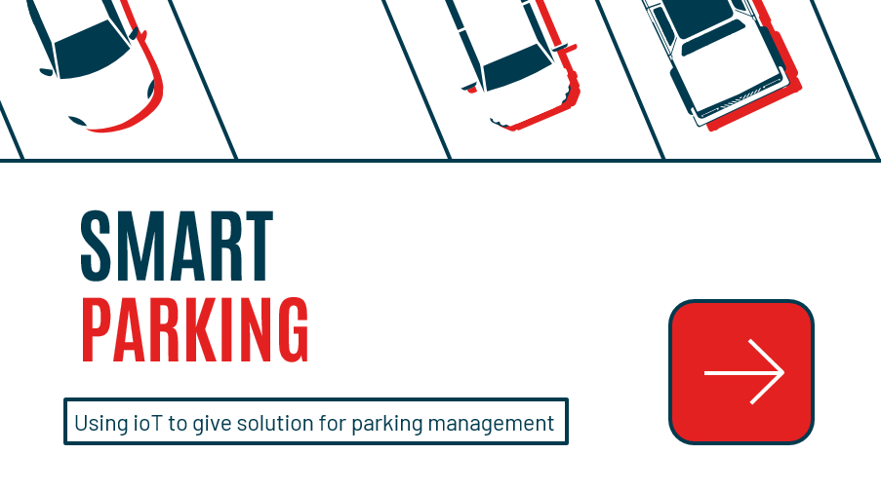
CONCLUSION
The concepts of smart cities have always been a dream.
There have been advancements made from the past couple
of years to make smart city dream to reality. The
advancement of internet of things and cloud technologies
has given rise to the new possibilities in terms of smart
cities. Smart parking facilities have always been the core of
constructing smart cities.Asfor the future work the
users can book a parking space from a remote location.GPS,
reservation facilities and license plate scanner can be
included in the future.

Slide 18
THANK YOU!

